Slide 1
Docker Best Practice
OW

Slide 2
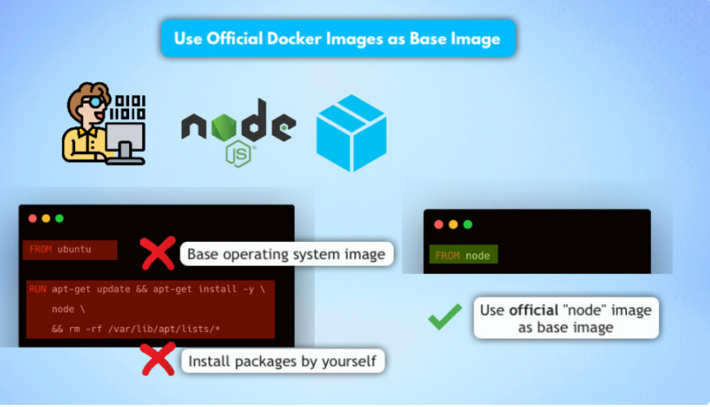
Use an official and verified Docker image as a base image
Let's say you are developing a Node.js application and want to build and run it as a Docker image.
Instead of taking a base operating system image and installing node.js, npm and whatever other tools you need for your application, use the official node image for your application.

Slide 3
Specific docker image version
we have selected the base image, but now when we build our applications image from this Dockerfile, it will always use the latest tag of the node image.
Now why is this a problem?
❌ - you might get a different image version as in the previous build
❌ - the new image version may break stuff
❌ - latest tag is unpredictable, causing unexpected behavior
So instead of a random latest image tag, you want to fixate the version and just like you deploy your own application with a specific version you want to use the official image with a specific version.

Slide 4
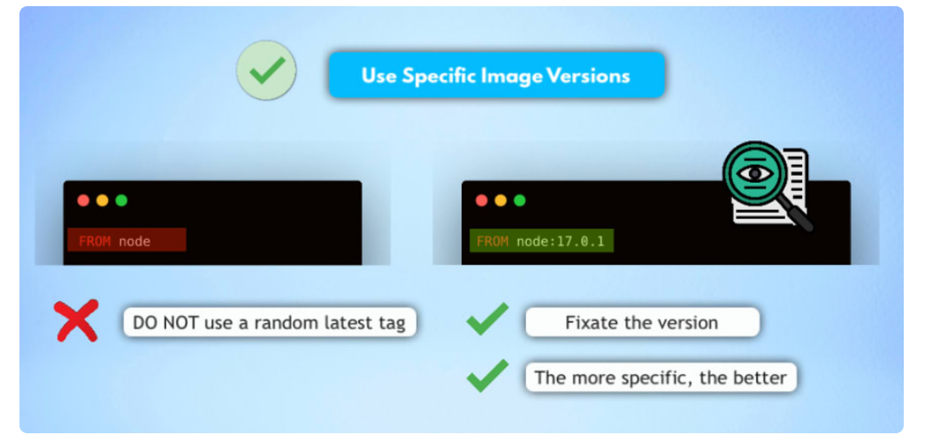
..

Slide 5
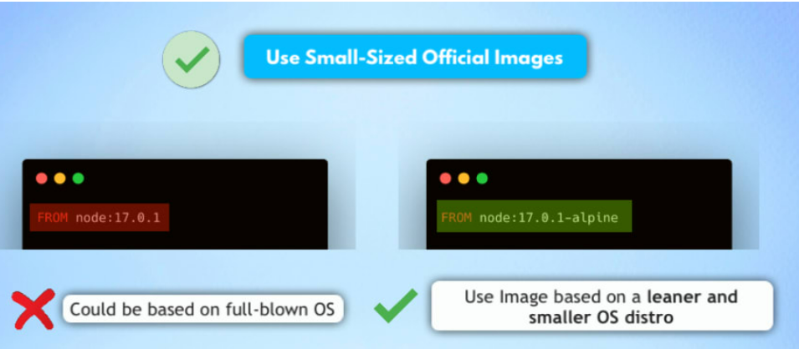
Image Selection
Take base image based on requirement, don’t take full os images
Check the Vulnerability index for the images

Slide 6
Layering
Dockerfile each command or instruction creates an image layer.
So when we use a base image of node alpine like in the above example it already has layers, because it was already built using its own Dockerfile. Plus, in our Dockerfile on top of that we have a couple of other commands that each will add a new layer to this image.
Now what about caching? Each layer will get cached by Docker. So when you rebuild your image, if your Dockerfile hasn't changed, Docker will just use the cached layers to build the image.

Slide 7
..
Advantages of cached image layers: ✅ - Faster image building ✅ - Faster pulling and pushing of new image versions
Optimize the Caching So to optimize the caching, you need to know that: Once a layer changes, all following or downstream layers have to be re-created as well
Order your commands in the Dockerfile from the least to the most frequently changing commands to take advantage of caching and this way optimize how fast the image gets built

Slide 8
Use .dockerignore file
Now usually when we build the image, we don't need everything we have in the project to run the application inside. We
don't need the auto-generated folders, like targets or build folder, we don't need the readme file etc.
So how do we exclude such content from ending up in our application image?
👉 Using a .dockerignore file.
It's pretty straightforward. We basically just create this .dockerignore file and list all the files and folders that we want to be ignored and when building the image, Docker will look at the contents and ignore anything specified inside.

Slide 9
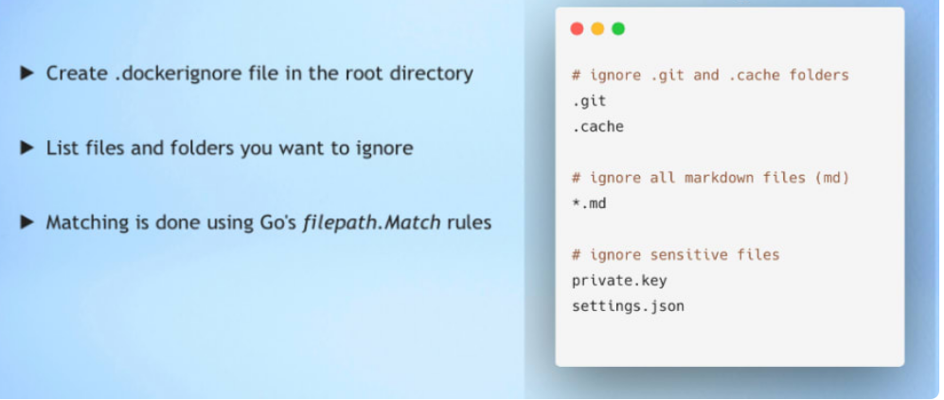
..

Slide 10
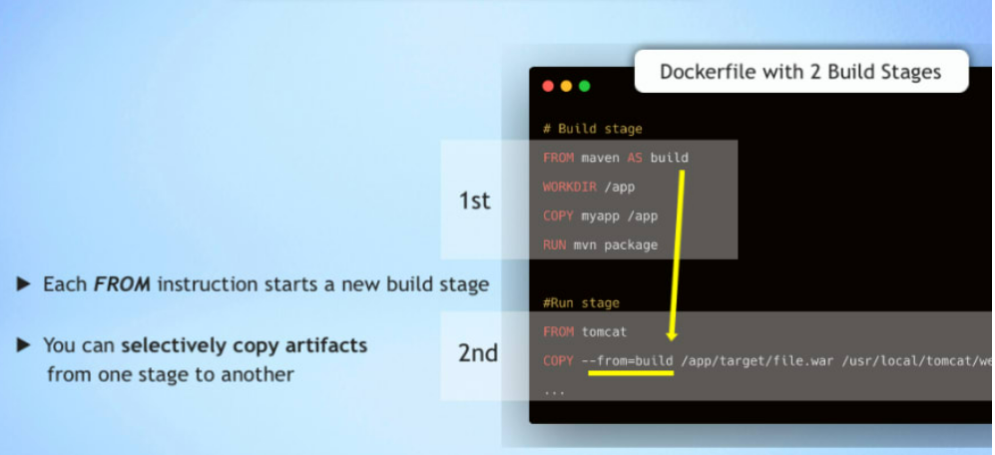
Multi-Stage Build
Assume you need certain tools while building the image, that tools is not required in the final image
Instead of using single image you can create multi-stage builds

Slide 11
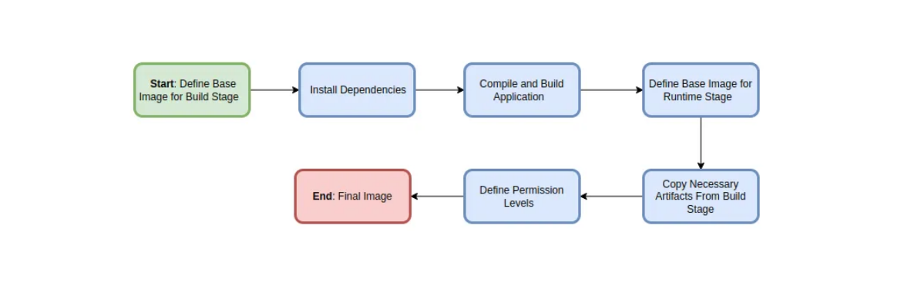
..

Slide 12
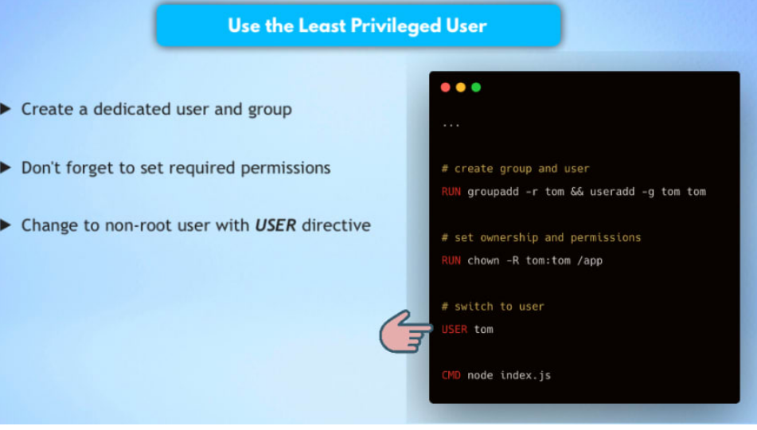
Use least-privileged user
Now, when we create this image and eventually run it as a container, which operating system user will be used to start the application inside? By default, when a Dockerfile does not specify a user, it uses a root user. But in reality there is mostly no reason to run containers with root privileges.

Slide 13
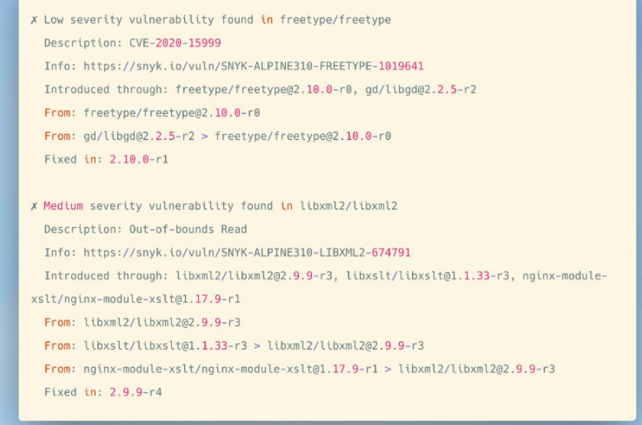
Scan for vulnerabilities

